Slide 1
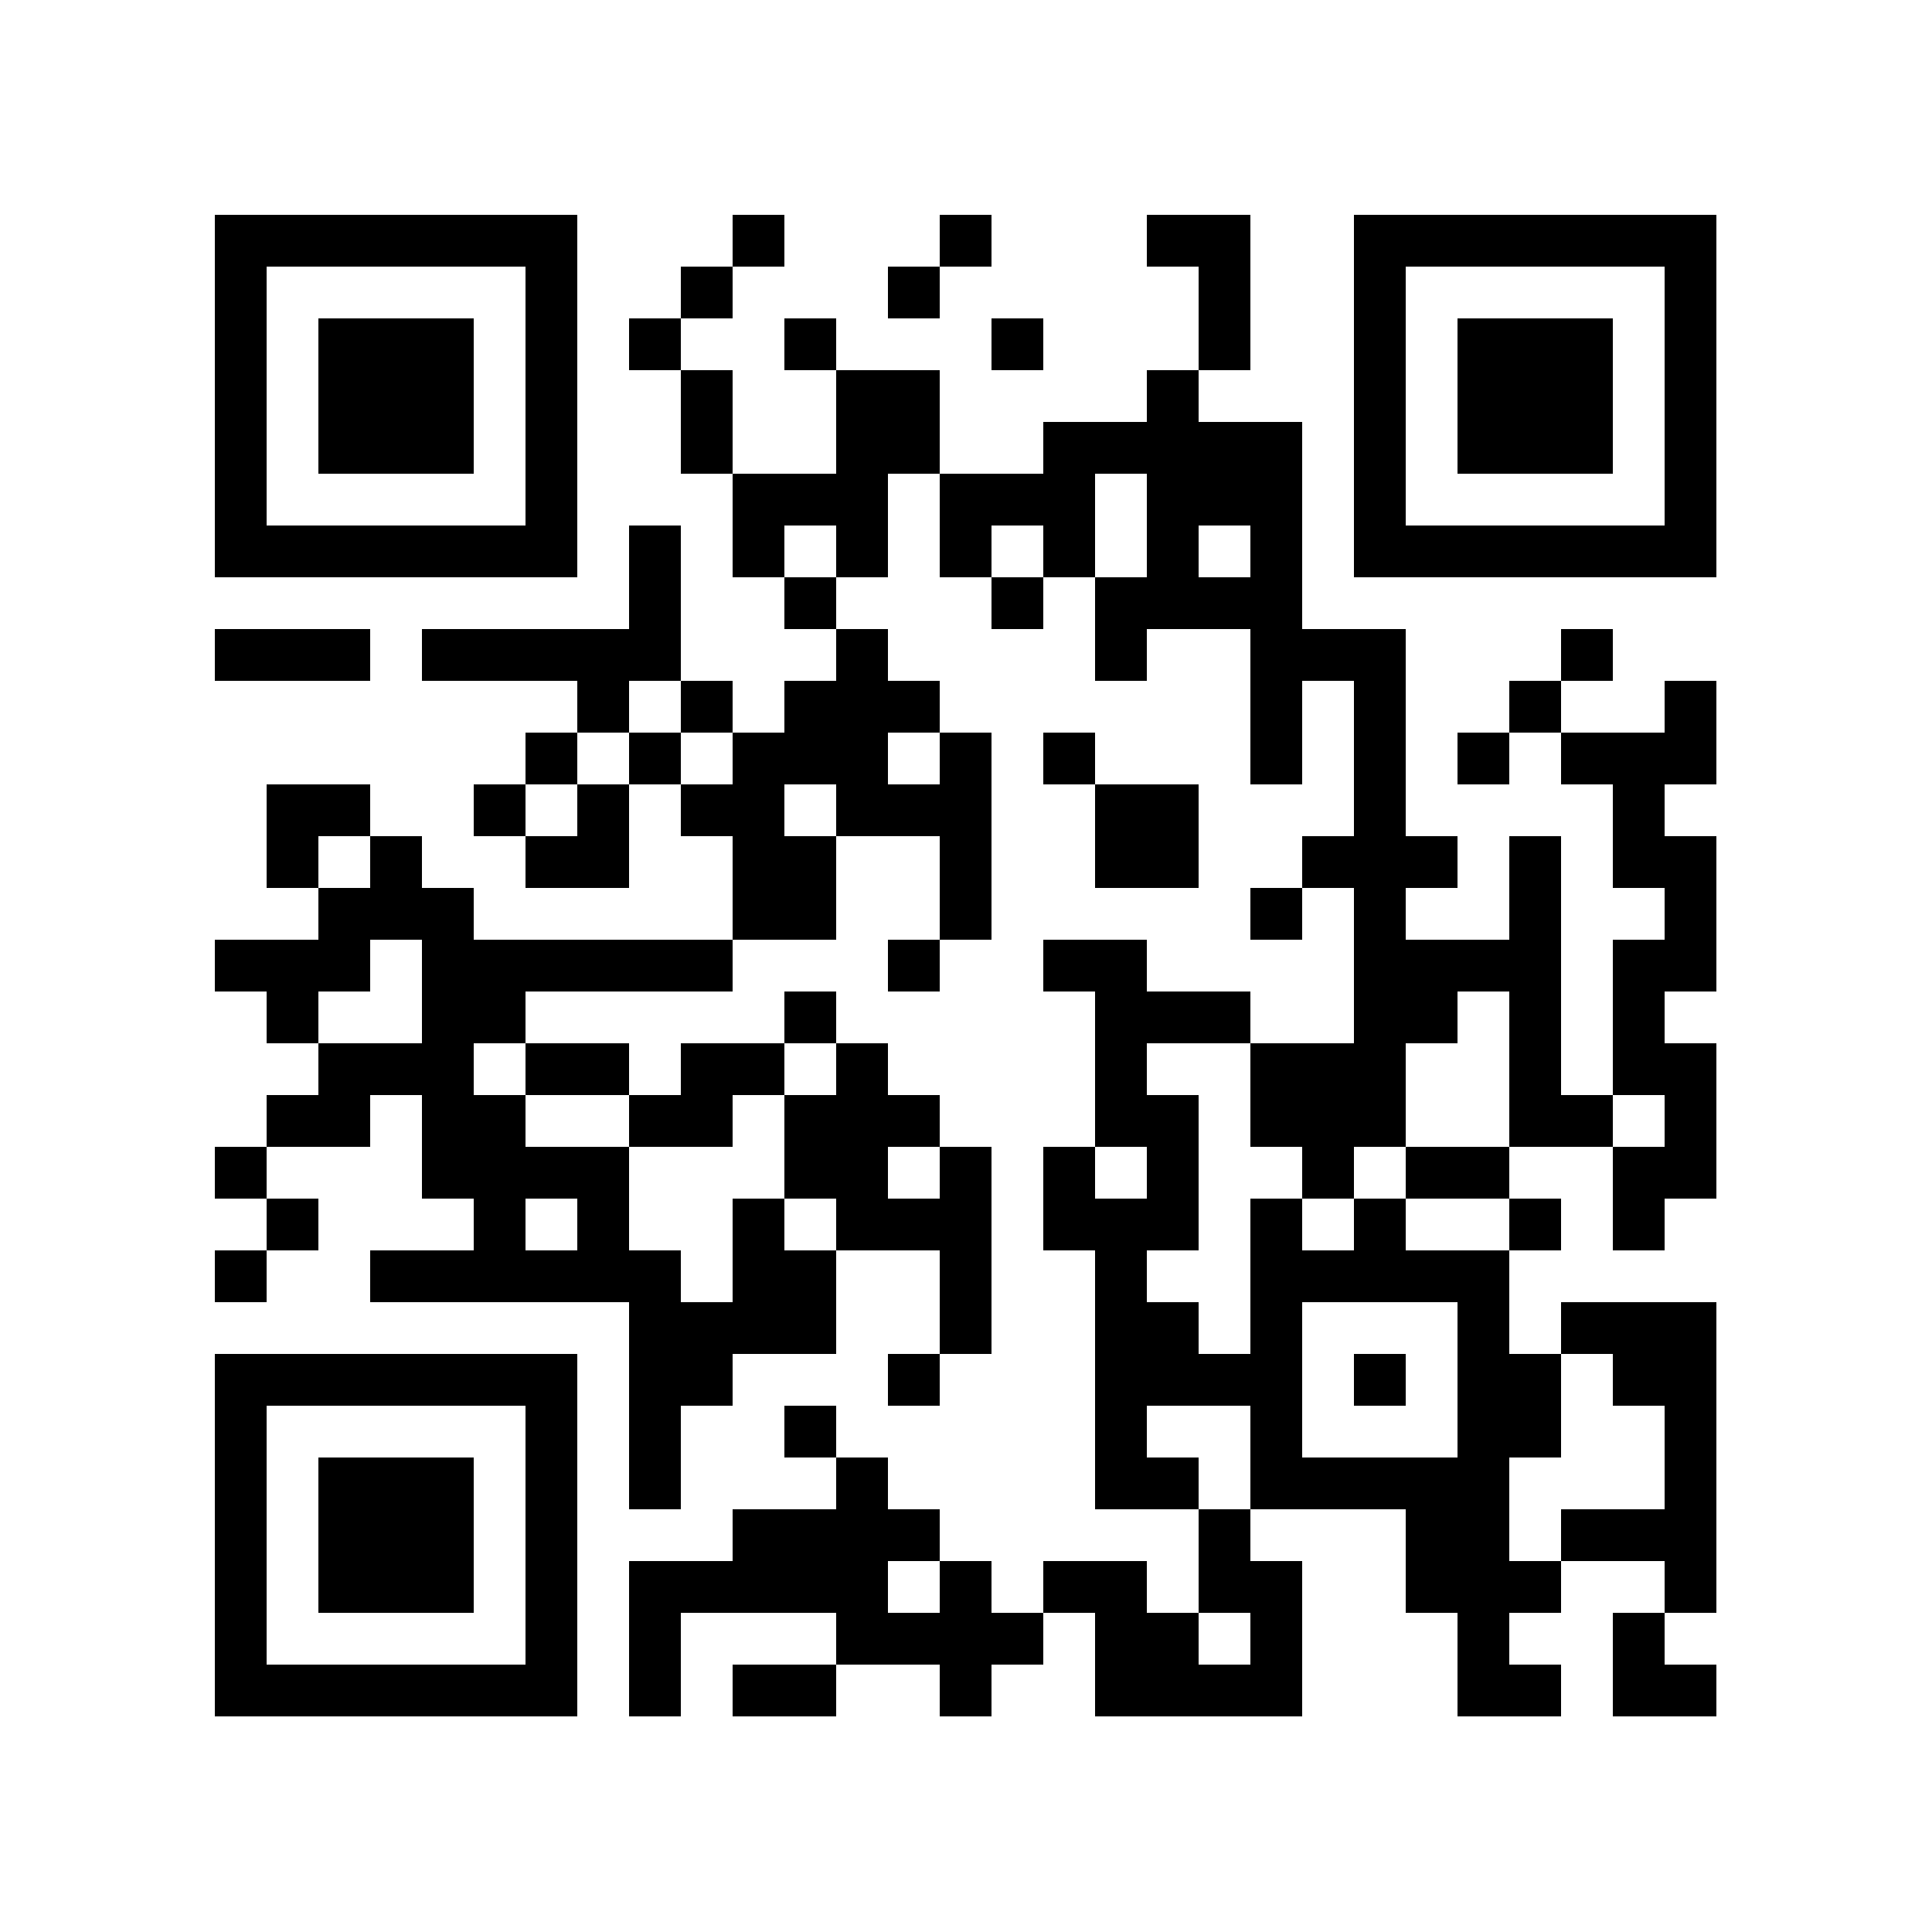
036221

Slide 2
COMP1314
Data Management

Slide 3
Who?
Danesh Tarapore (Unix & Scripting)
  d.s.tarapore@soton.ac.uk
Tom Blount (Structured Data, Databases)
  t.blount@soton.ac.uk
Rahman Attar (Relational Algebra, Databases in Practice)
  aaq1d22@ecs.soton.ac.uk
Angelos Nikolopoulos (Senior lab demonstrator)
  arn1r23@soton.ac.uk
Email the team
  COMP1314-instructors@all.soton.ac.uk

Slide 4
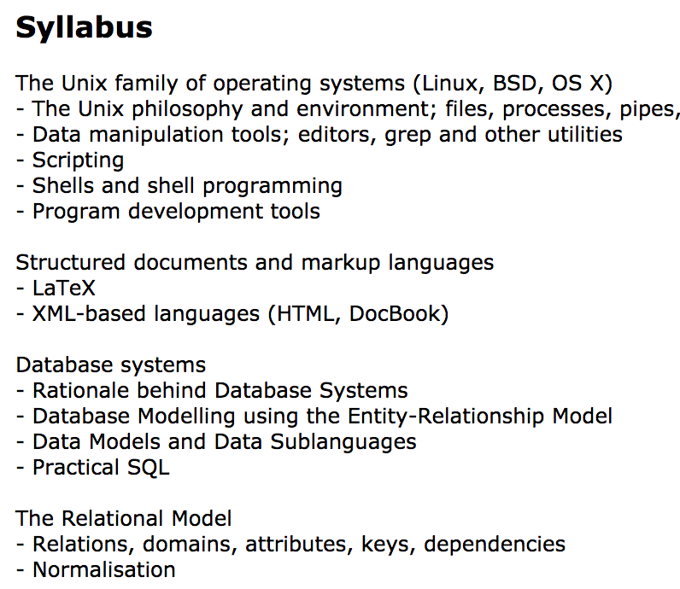
What?
https://moodle.ecs.soton.ac.uk/course/view.php?id=91
The syllabus is
what you are
examined on!

Slide 5
Our Journey
Data-based operating systems
Unix and Unix-like
  Unix fundamentals
  Scripting for data processing
Structured data representation
Databases
  How they work
  What they can do
  SQL and NoSQL
Putting it all together

Slide 6
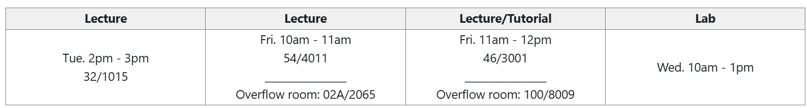
When?
https://moodle.ecs.soton.ac.uk/course/view.php?id=481
Always check the Timetable to know what’s happening
Timetable
Capacity:
426
213
354

Slide 7
Livestreaming and Q&A
If the lecture theatre is full, you can head to the overflow room or a quiet spot (Library, B60 Labs, B100 etc.) to watch the stream.
Link to the livestream will be available on the Moodle schedule.
If you have any questions while watching the livestream,
  Login to MS Teams using your university account
  Find your class COMP1314-45772-25-26
  Post questions on “Q and A Board” channel
  Angelos will be monitoring the channel and communicate your questions to the lecturer.

Slide 8
Resources for you
Please bookmark us on Moodle:
https://moodle.ecs.soton.ac.uk/course/view.php?id=481
The module’s Moodle page is where you’ll find
  Lecture notes
  Pre-recorded tutorials
  Recordings of lectures
  Links to Lab scrips
  and more ….

Slide 9
How?
Lectures
  To help guide you and start your journey
Labs (30% from COMP1300 – the Lab module)
  Four assessed labs – D1, D2, D3 and D4 (20%). First lab, D0, is unassessed.
  Other assessments from COMP1300 (10%)
Coursework (30%)
  Putting theory into practice
  Unix + Databases
Exam (40%)
  Making sure you understand the theory

Slide 10
UNIX operating system

Slide 11
Data-based Operating Systems
Some operating systems better tailored to handling data
UNIX and UNIX-like operating systems
  Base utilities
    For processing and manipulating files
  Pipelines
    From one application into the next
  Scripting
    Getting more complex
  Developer-oriented
    Open-source libraries and languages at your fingertips
    Python, R etc.

Slide 12
Getting to know UNIX
The UNIX design philosophy.
Navigate your way around the UNIX file-system.
Manipulate UNIX files and data.
Launch and control jobs (programs) on a UNIX server.
Write UNIX scripts to automate various tasks:
  e.g. downloading data from websites and extracting useful information like stock index prices for analysis.

Slide 13
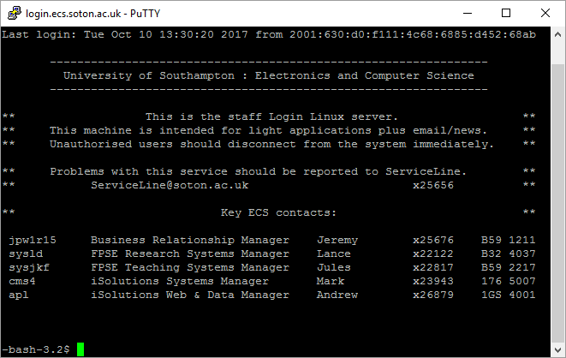
Interactive sessions
IPv6 address
shell
shell-prompt

Slide 14
“Classic” Databases with Tom

Slide 15

I’m Tom
I’m Tom!
I was an undergraduate here at Southampton
Now, I teach!
I like games, and creative computing
Show, don’t tell. And better yet, do don’t show!

Slide 16
COMP1314
Teaching approach
  Learning by doing
  We’ll be mixing practical and theory together
Mixed sessions
  We’ll have a mixture of lecture and lab sessions
  But even the lectures will have some interactive bits
Learn and practice
  We’ll learn some things, try them out, put them into practice, get any help and answer any questions and then move on to the next thing

Slide 17
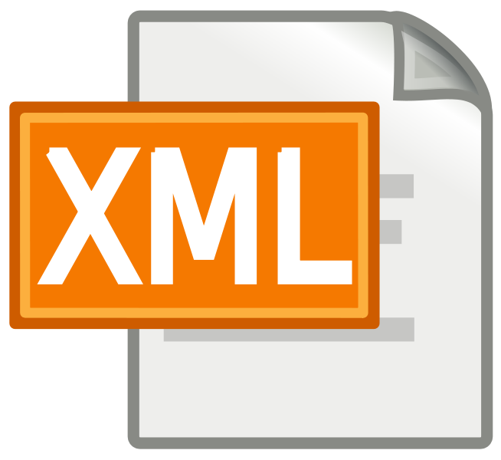




My Part of the Module
Structured data
  Why bother structuring data?
  How to define, create, invent, validate
  Common formats and languages
“Classic” Databases
  Why and where they’re used
  Some of the maths behind them
  How to use and manipulate them

Slide 18
Relational Algebra &
Databases in Practice with Rahman Attar

Slide 19


Computer Scientist in Artificial Medical Intelligence
Dr Rahman Attar, SMIEEE, MIET, FHEA, PhD, MPhil, BEng
Lecturer @ School of Electronics and Computer Science, University of Southampton | r.attar@southampton.ac.uk
Honorary Research Fellow @ Department of Bioengineering, Imperial College London | r.attar@imperial.ac.uk
attarlab.com

Slide 20
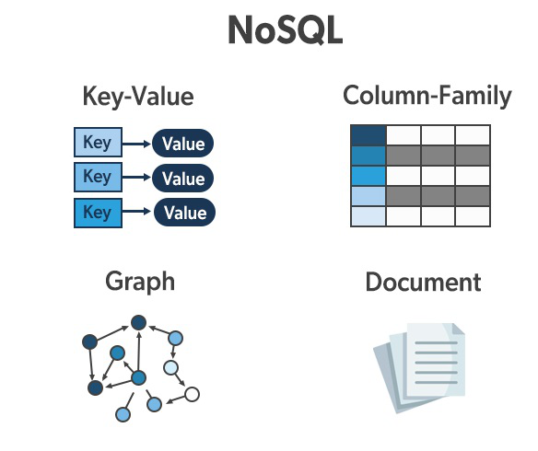
What topics will I be covering?
Overview of traditional relational databases
Limitations of relational databases
Introduction to NoSQL databases
Types of NoSQL databases
Basic operations and queries in NoSQL databases
Schema design in NoSQL databases
Challenges and considerations in choosing NoSQL databases

Slide 21

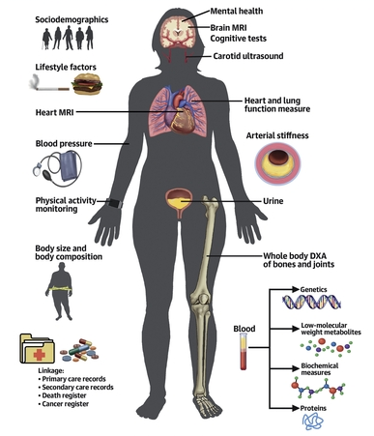
Why are these topics important?
one of the world’s largest population studies
The UK Biobank contains a vast amount of health-related data, imaging data, genetic information, and more from a large number of participants. A combination of technologies is used to efficiently manage and query such a diverse and extensive dataset.
UK Biobank utilises a complex and comprehensive data storage infrastructure to manage its vast dataset. The UK Biobank doesn't rely on a single type of database but rather employs a combination of databases.

Slide 22
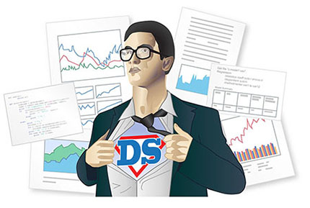
COMP1314 Coursework
Counts for 30% of this module
Write UNIX scripts to extract useful data from a very large dataset.
Then structure this data as a database and write queries to efficiently access it.
Write a report on the project in LaTeX
Coursework will be set in the end of Week 2 of the module.

Slide 23
The COMP1314 exam
40% of the module
Testing the underlying theory to the practice
An entirely computer-based multiple-choice exam
  However, testing not just memorisation, but understanding
  Type of MCQ you can expect will be covered in revision lectures.

Slide 24
What you need to know for your labs with Angelos Nikolopoulos

Slide 25

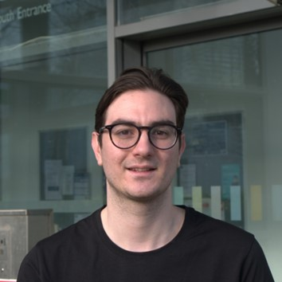
A little bit about me…
Currently a 3rd Year PhD Student within ECS
  Research Group: Electrical Power Engineering (EPE)
  Research interests: Solar Forecasting and Statistical Analysis.
Have been a lab demonstrator for:
  Student ECS Mentoring Program
  Machine Learning Technologies (COMP3222)
  Data Management (COMP1314)
Senior demonstrator for COMP1314
  Feel free to approach me and ask questions!
arn1r23@soton.ac.uk

Slide 26
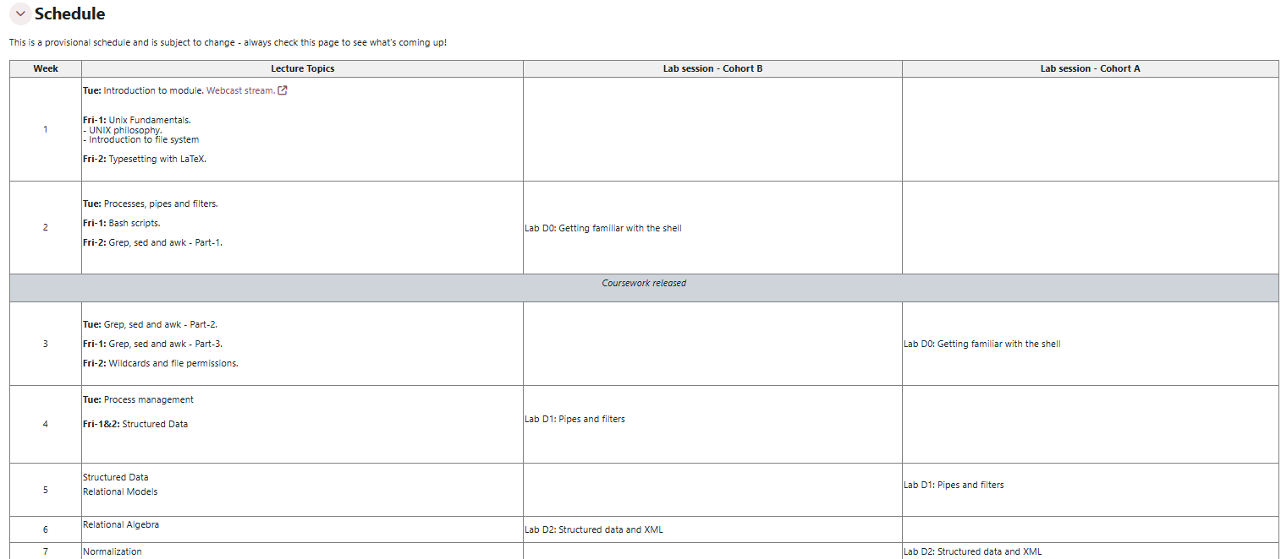
Lab Sessions
Wednesday - B59/3229 ECS Computing Lab
Please check the schedule for your cohort slot
https://moodle.ecs.soton.ac.uk/course/view.php?id=481

Slide 27
Lab Structure
D0 – Introduction, setting up your UNIX environment.
D1 – UNIX bash scripts, pipes and filters.
D2 – Structured data
D3 – SQL databases
D4 – NoSQL databases
Assessed labs

Slide 28
Assessed labs
Each lab D1-D4 assessed based on four equally weighted criteria:
  Preparation – How well are you prepared for the lab. Questions released a week before the scheduled lab.
  Progress and Understanding – Assessed during the lab.
  Logbook – Note down answers to lab exercise in your logbook.

Slide 29
A word of caution regarding lab environment and CW
Some of you are already familiar with Linux/other UNIX systems
  That’s great!
Some of you probably have your own Linux boxes up and running
  That’s also fantastic!
In this module, we expect you to use a specified Linux distribution, and not any other environments!
There are occasional subtle differences between implementations of core tools, so make sure your code works on the environment provided!

Slide 30
What’s next!
Today: Introduction
Friday lecture: UNIX philosophy + file-system introduction.
Friday tutorial: LaTeX typesetting system.
Next week, D0 lab session on Wednesday (for Cohort B): Getting Started
  Setting up your environment
  Becoming familiar with the tools
  Getting ready for the coursework

